Slide 1
TWO YEARS WITH GRADLE IN ENTERPRISE
by Serhii Belei

Slide 2
AGENDA
WHAT IS GRADLE
CONFIGURATION OF DEVELOPMENT TASKS
MOVING BUILD LOGIC TO PLUGIN
LESSONS LEARNED

Slide 3

AGREEMENTS
You may ask your questions during the talk
I may answer immediately or at the end
Almost all links have QR codes on the same slide
Project with samples located at https://github.com/crc83/DEMO-gradle-sample-plugin

Slide 4
WHAT IS GRADLE
GRADLE IS A BUILD TOOL

Slide 5

THANK YOU

Slide 6
WHAT IS BUILD TOOL IN 2000
1) Tool that is able to create jar, war or ear file with some customizations

Slide 7
WHAT I EXPECT FROM BUILD TOOL TODAY
1) Create jar, war or ear file
2) Make your documentation visible to users
3) Keep CI job configuration inside script
4) Provide abilities to control project quality
5) Provide single task to build project
6) Do project/customer specific ceremonies [i.e. specific records in manifest file, string processing in project, connect new project with legacy one's]
7) Contain IDE configuration inside script

Slide 8

CREATE SOURCES & JAVADOC JARS
task sourcesJar(type: Jar, dependsOn: classes) {
classifier = 'sources'
from sourceSets.main.allSource
}
task javadocJar(type: Jar, dependsOn: javadoc) {
classifier = 'javadoc'
from javadoc.destinationDir
}
https://stackoverflow.com/questions/11474729/how-to-build-sources-jar-with-gradle

Slide 9

DON’T REINVENT THE WHEEL
You may use existing plugin from nebula (Netflix)
https://plugins.gradle.org/plugin/nebula.source-jar
Or you can search at plugins.gradle.org
The only reason to implement it by your own is to add some customization that is impossible to add to existing one.

Slide 10
DOCUMENTATION VISIBLE TO USERS 1
Let’s declare plugin artifact on the top of the script
buildscript {
repositories {maven {url "https://plugins.gradle.org/m2/"}}
dependencies {
classpath('org.asciidoctor:asciidoctor-gradle-plugin:1.5.3',
'org.asciidoctor:asciidoctorj-pdf:1.5.0-alpha.11')
}
}

Slide 11
DOCUMENTATION VISIBLE TO USERS 2
Declare plugin name and it’s configuration
…
apply plugin: 'org.asciidoctor.convert‘
…
asciidoctor {
backends 'html5', 'pdf'
}

Slide 12

DOCUMENTATION VISIBLE TO USERS 3
src\docs\asciidoc\index.adoc
= {project-name}
{project-version}
== Overview
….
https://github.com/crc83/DEMO-gradle-sample-plugin/commit/aa065f1d197e99fe622366709a1aea958174c660

Slide 13
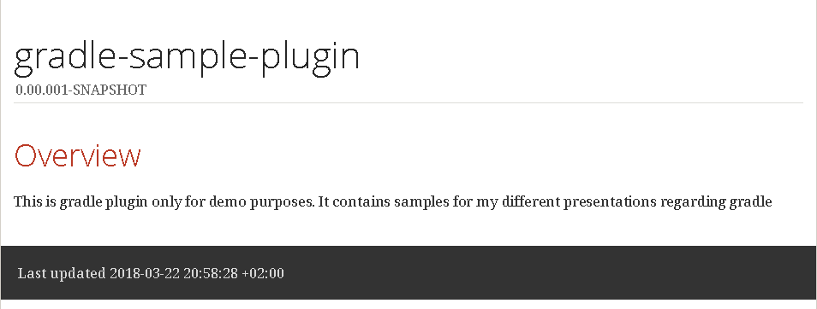
DOCUMENTATION VISIBLE TO USERS
Result in HTML

Slide 14
CI JOB CONFIG INSIDE SCRIPT #1
Add repository and dependencies
buildscript {
repositories {
maven {url "http://repo.jenkins-ci.org/releases/"}
maven {url "https://plugins.gradle.org/m2/"}
}
dependencies {
classpath('com.sbelei:gradle-jenkins-plugin:1.4.9')
}
}

Slide 15
CI JOB CONFIG INSIDE SCRIPT #2
Apply plugin and add configuration
apply plugin: 'com.sbelei.jenkins‘
jenkins {
….
}
https://github.com/crc83/DEMO-gradle-sample-plugin/commit/147541bca4b41291ad730c5bc8e200b9aeb3785a

Slide 16
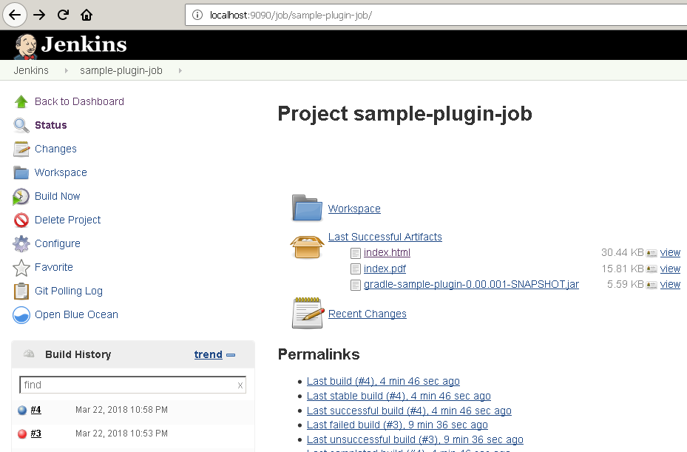
CI JOB CONFIG INSIDE SCRIPT

Slide 17
CONTROL PROJECT QUALITY
To control project quality we use Cobertura and SonarQube.
Cobertura provide information regarding test code coverage
SonarQube provide information regarding code complexity, code duplications, code smells e.t.c.

Slide 18

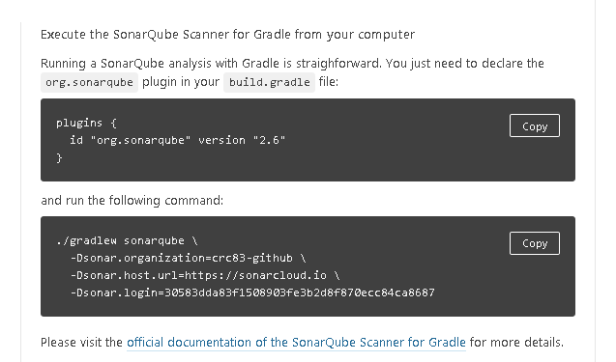
SONARQUBE 1
I used SonarQube in the cloud for opensource projects (you may install server localy if you like) https://sonarcloud.io

Slide 19
SONARQUBE 2
Plugin declaration differs from one on screenshot. I checked out newer version at plugins.gradle.org
buildscript {
dependencies {
classpath('org.sonarsource.scanner.gradle:sonarqube-gradle-plugin:2.6.2')
}
}
apply plugin: 'org.sonarqube‘

Slide 20
SONARQUBE 3
test { ignoreFailures = true }
sonarqube {
properties {
property "sonar.sourceEncoding", "UTF-8"
property "sonar.organization", "crc83-github"
property "sonar.host.url", "https://sonarcloud.io"
property "sonar.login", "${github_sonar_token}"
}
}

Slide 21
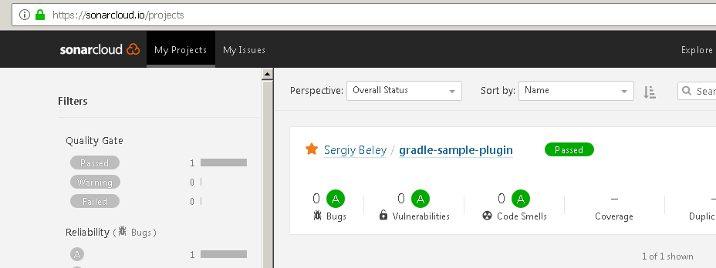
SONARQUBE 4
C:\project>gradle sonaruqbe

Slide 22

SONARQUBE 5
Overview of changes you may find here as usual
https://github.com/crc83/DEMO-gradle-sample-plugin/commit/c3da505a122940743b880cb3b21f72c2b6bdd8de

Slide 23
COBERTURA 1
The configuration is pretty similar at the beginning
…
classpath('org.sonarsource.scanner.gradle:sonarqube-gradle-plugin:2.6.2‘)
…
apply plugin: 'net.saliman.cobertura'

Slide 24
COBERTURA 2
Configuration itself
configurations.all { resolutionStrategy {
force 'org.ow2.asm:asm:5.0.3'
forcedModules = [ 'org.ow2.asm:asm:5.0.3' ]
} }
cobertura {
coverageFormats = ['html', 'xml']
coverageIgnoreTrivial = false //because of NPE's during coverage measurment
coverageReportDir = file("${buildDir}/reports/cobertura")
}

Slide 25
COBERTURA 3
Also we have to add extension for sonar config (Since sonar uses cobertura reports)
sonarqube {
properties {
…
property "sonar.cobertura.reportPath", file("${buildDir}/reports/cobertura/coverage.xml")
}
}

Slide 26
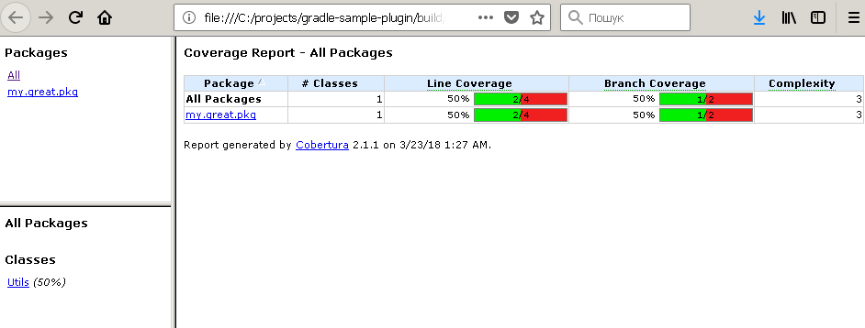
COBERTURA 4
Run gradle cobertura and see report

Slide 27
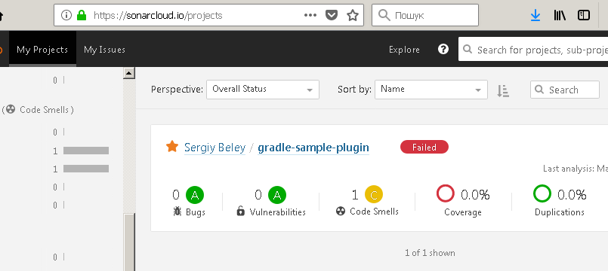
COBERTURA 5
Sonar also show details from report

Slide 28
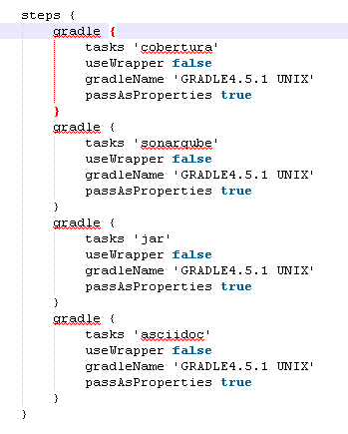
SINGLE TASK TO BUILD PROJECT 1
You may notice that our CI config now looks like

Slide 29

SINGLE TASK TO BUILD PROJECT 2
I’d like to have single dailyBuild task
task dailyBuild(type: GradleBuild) {
tasks = ['cobertura', 'sonarqube' , 'jar', 'asciidoc']
}
https://github.com/crc83/DEMO-gradle-sample-plugin/commit/9cf314d30f6ba329996780c9285b60662ab5fee1

Slide 30
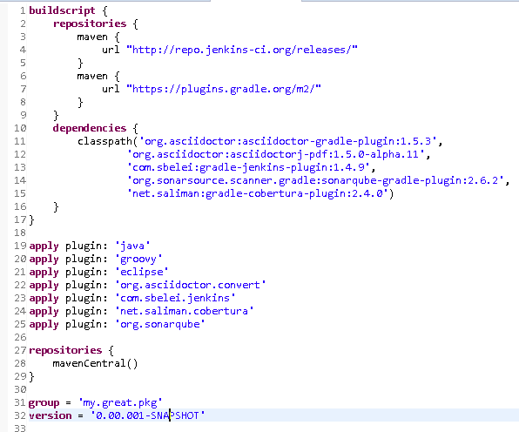
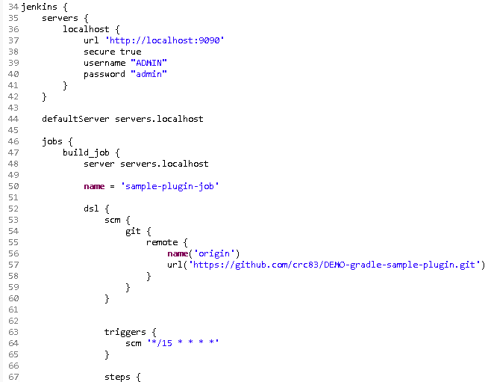
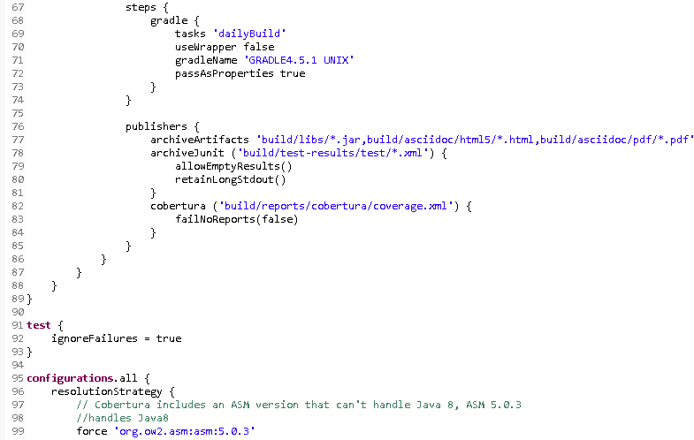
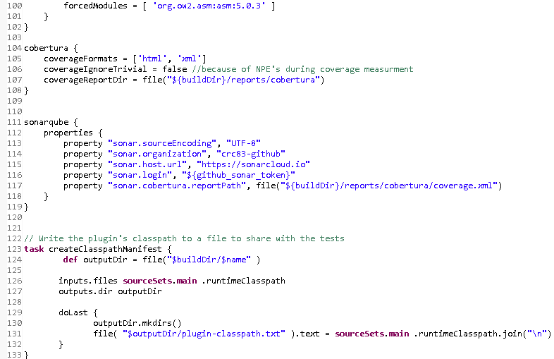
GREAT SCRIPT FOR ONE PROJECT

Slide 31
WHAT IF WE HAVE MORE THAN ONE PROJECT
The solution could be just create a plugin.
But for this reason I have to create separate project (what kind of project?) and create some structure there (what structure?) and add correct dependencies (what dependencies?).
Thank I have to rewrite somehow (how to do it?) my well working scripts (how much of time I need?). Than I have to check (how?) if my plugin work (do it a lot of times?).
I have to store this plugin somewhere and obviously I have to apply plugin to itself (because it’s also a project that require common steps for my organization).

Slide 32
A LOT OF QUESTIONS TO DO ONE STEP
Copypaste is much faster for two projects
Copypaste is much faster for three projects
Copypaste is much faster for four projects
…
There is a limit, but what happen at the end of story?

Slide 33
SCRIPT EVOLVES
Project 1
Project 1.1
Project 1.3
Project 2
Project 2.1
What script will be a blueprint for Project 4?
Project 3
Project 4

Slide 34
WHY WE DID COPYPASTE?
Because of a lot of what’s
No other reasons

Slide 35
WHAT YOU SHOULD KEEP IN MIND
Gradle script is not a script. Gradle script is processed in three phases: initialization, configuration and execution
“Project” is object that explicitly imported in script. Hence you use a lot of methods of project object.

Slide 36
LET’S ELIMINATE THESE WHAT’S
Gradle plugin is a simple gradle project.
That means you can use Java, Groovy or Kotlin there.
Groovy is preferred if you would like to move your logic as fast as possible.

Slide 37

GRADLE PLUGIN PROJECT TEMPLATE
C:.
│ build.gradle
│ README.md
│
└───src
└───main
├───groovy
│ └───my
│ └───great
│ └───pkg
│ MyGreatPlugin.groovy
│
└───resources
└───META-INF
└───gradle-plugins
my-super-plugin.properties
https://github.com/crc83/DEMO-gradle-sample-plugin/tree/a82901027d4ccd427bd3a755b62920af6a03ce9e

Slide 38
TALK IS CHEAP, SHOW ME THE CODE
package my.great.pkg
import org.gradle.api.Plugin
import org.gradle.api.Project
class MyGreatPlugin implements Plugin<Project> {
@Override
public void apply(Project prj) {
// TODO Auto-generated method stub
}
}

Slide 39
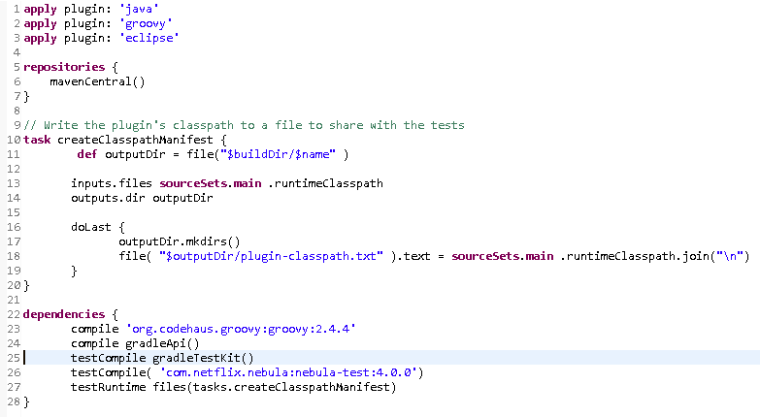
WHAT IS IN GRADLE BUILD ITSELF

Slide 40
WHAT IS IN GRADLE BUILD ITSELF
dependencies {
compile 'org.codehaus.groovy:groovy:2.4.4'
compile gradleApi()
testCompile gradleTestKit()
testCompile( 'com.netflix.nebula:nebula-test:4.0.0')
testRuntime files(tasks.createClasspathManifest)
}

Slide 41
LET’S CHECK WHAT’S LEFT
The solution could be just create a plugin.
But for this reason I have to create separate project (what kind of project?) and create some structure there (what structure?) and add correct dependencies (what dependencies?).
Thank I have to rewrite somehow (how to do it?) my well working scripts (how much of time I need?). Than I have to check (how?) if my plugin work (do it a lot of times?).

Slide 42
HOW TO DO IT 1
Add project. variable before file; dependencies; configurations; etc
@Override public void apply(Project prj) { prj.apply plugin: WarPlugin prj.dependencies { compile prj.fileTree(

Slide 43
HOW TO DO IT 2
Use project.beforeEvaluate and project.afterEvaluate
project.afterEvaluate { prj.sonarqube {
properties {

Slide 44
HOW TO DO IT 3
Sometimes you don’t need it (beforeEvaluate and afterEvaluate)
project.cobertura {
coverageFormats = ['html', 'xml']

Slide 45
HOW TO DO IT 4
Local pathes like "my/path" replace with "${project.buildDir}/my/path“
into "${project.buildDir}/tmp/someFolder"

Slide 46
HOW TO CHECK
From your project where your plugin is applied run
>gradle someTask --include-build=path-to-your-plugin

Slide 47

HOW TO TEST IT A LOT OF TIMES
You may refer to this article:
https://crc83.blogspot.com/2016/03/i-getting-started-with-environment.html

Slide 48
LESSONS LEARNED
Store secured information in c:\Users\%user_name%\.gradle\gradle.properties
Release plugin each time you did more or less significant change
Document your plugin
Share information among the teams instantly
Write tests even for obvious steps
Use conventions over configurations
Make script a “single point of truth” for the project

Slide 49
QUESTIONS?

Slide 50
THANK YOU

Slide 51
